Slide 1
Session 1. Sudden Cardiac Death: Risk Stratification and Management
Approach for Diagnosing Idiopathic VF
김 성 환
가톨릭의대 서울성모병원

Slide 2
Diseases causing VT/VF
Structural heart disease (=ventricular scar)
  Ischemic heart disease (including spasm)
  DCMP, HCMP
  Arrhythmogenic RV dysplasia, sarcoidosis, amyloidosis, surgical scar…
Inherited primary arrhythmia syndromes
  Long/Short QT syndrome
  Catecholaminergic polymorphic VT
  Brugada syndrome
  Early repolarization syndrome
  Idiopathic ventricular fibrillation

Slide 3
Brugada syndrome
‘Widow ghost’ in Thailand
Prevalent in east Asian male
Early repolarization syndrome
Brugada syndrome
Kim SH et al, J Cardiovasc Electrophysiol 2012
Notes:
젊은 남성이 수면 중에 급사하는 경우는, 수백년 전부터 태국 등 동남아를 중심으로 관찰되어 왔음.
젊은 남성이 급사하였기 때문에, widow ghost 라고도 불려왔고, 남자에게 여자 옷을 입히고 자게하는 풍습도 생겨났음.
Brugada 등이 1992년에 SCD 환자에서 특징적인 심전도 모양을 가지는 경우를 관찰하여 보고한 뒤로, Brugada syndrome 이라 이름지어졌음.
근래의 연구에서도, 봄과 한밤 중에 event 가 집중되는 현상이 관찰됨.

Slide 4
Considerations of diagnosis
Dynamic change of ECG phenotype
Interaction of BS, early repolarization syndrome, and idiopathic VF (BS>ERS>IVF)

Slide 5
J wave syndrome
Brugada syndrome
Early repolarization syndrome
Kim SH, Nam GB et al, PACE 2017

Slide 6
Similarities and Differences
 | BS | ERS
 | Male (>80%), first age (30-50), mutation (SCN5A, KCNJ8, CACNA1C…), dynamicity, circadian/seasonal variation, short-coupled PVC, brady-dependent accentuation, isoproterenol/pacing/quinidine, hypothermia
Region | RVOT, V1-3 | Inferior LV, inferolateral leads
Epidemiology | BS=ERS in Europe | BS>ERS in Asia
AF prevalence | Higher | Lower
Ic drug | J ↑ | J ↓

Slide 7
Previous classification
IVF
ERS
Brugada

Slide 8
Current classification
IVF
ERS
Brugada

Slide 9
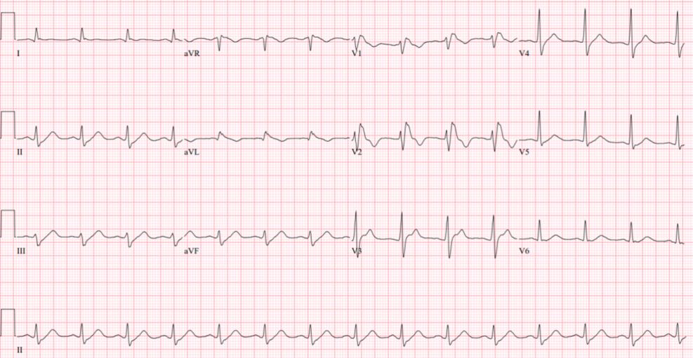
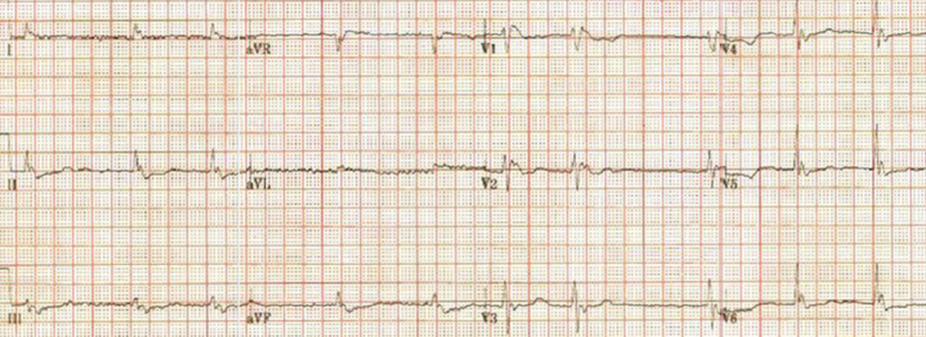
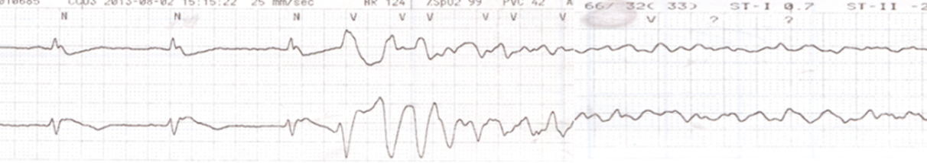
Dynamic change of J wave
2hr after hypothermia
Just after cardiac arrest
VF by PVC
Lee WS, Kim SH et al, Heart 2016

Slide 10
Provocation test
Long QT
  Epinephrine, Treadmil
Brugada syndrome
  flecainide

Slide 11
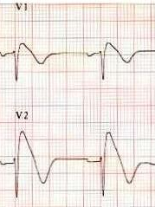
Brugada syndrome pattern ECG
1) Coved type (삿갓 모양)
2) J wave amplitude ≥2mm
3) Negative T wave
V1~2
≥1 lead
2nd, 3rd or 4th intercostal space
provocation test

Slide 12
Diagnosis of Brugada syndrome
Brugada pattern ECG
  + Symptoms (VF or aborted SCD, syncope, nocturnal agonal respiration, palpitations, chest discomfort)
  cf) Preexcitation ECG + symptom = WPW syndrome
  HIV + symptom/sign = AIDS

Slide 13
Diagnosis of Idiopathic VF
After exclusion of structural heart disease, long/short QT, CPVT, Brugada syndrome, Early repolarization syndrome…

Slide 14
감사합니다
Thank you!

